Slide 1
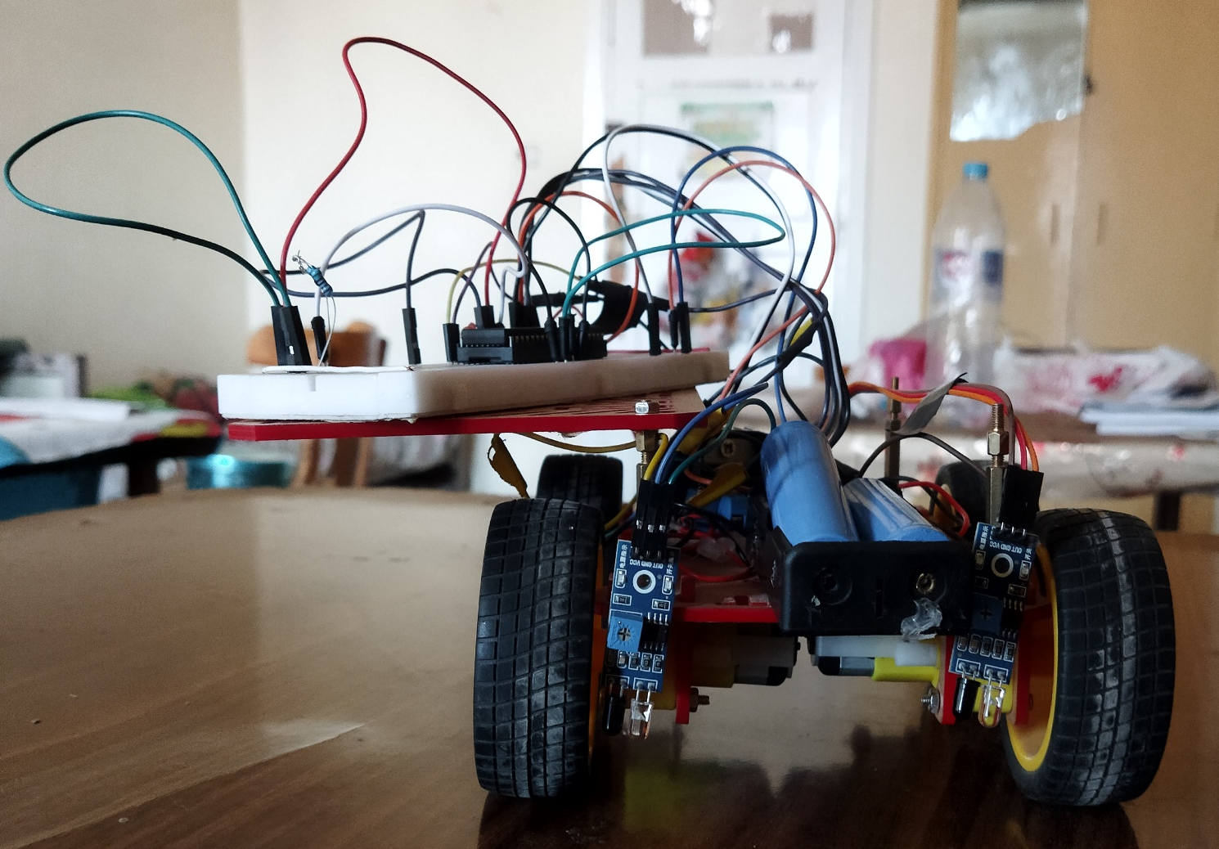
Line Follower Robot
Supervisor:
Dr. Khaled Elshafey

Slide 2
الاسماء:
1 – محمد مصطفى محمد جاد 123
2 – عبد العليم أحمد عبد العليم منا 70
3 – عمر مختار محمود بهنسي عاشور 92
4 – عبدالله محمد عبدالله عبد الغني 72
5 – الحسن امير على شرف الدين 33
6 – محمد فايز عبد الغفار بطاح 119

Slide 3
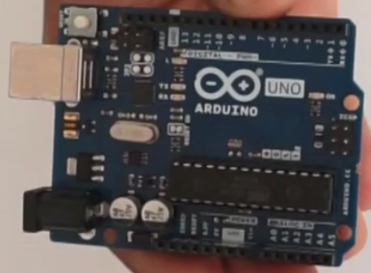
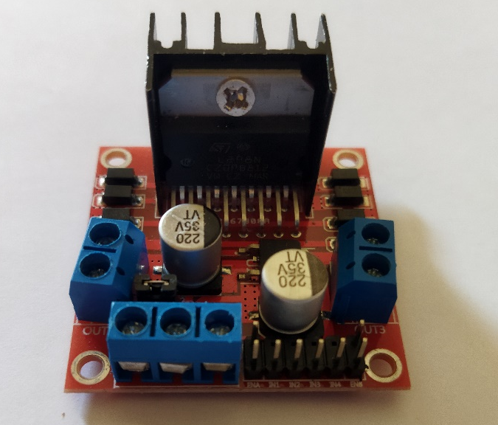
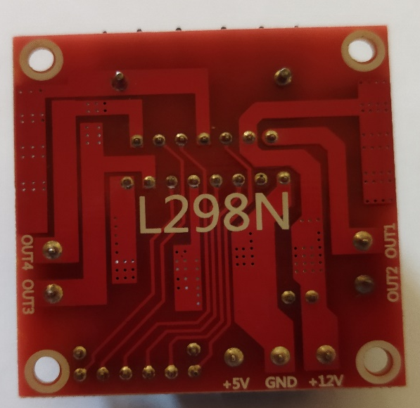
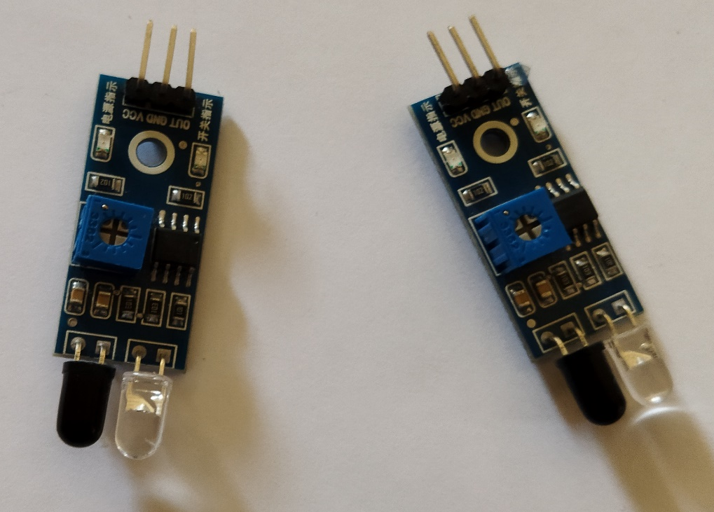
Components
1) Arduino 2) Motor Driver _ L298N
3) Two IR_Sensor
4) Double sided tape
5) Wires
6) Car chasls

Slide 4
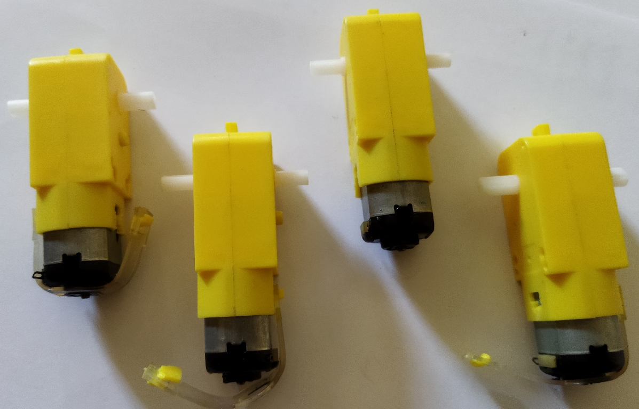
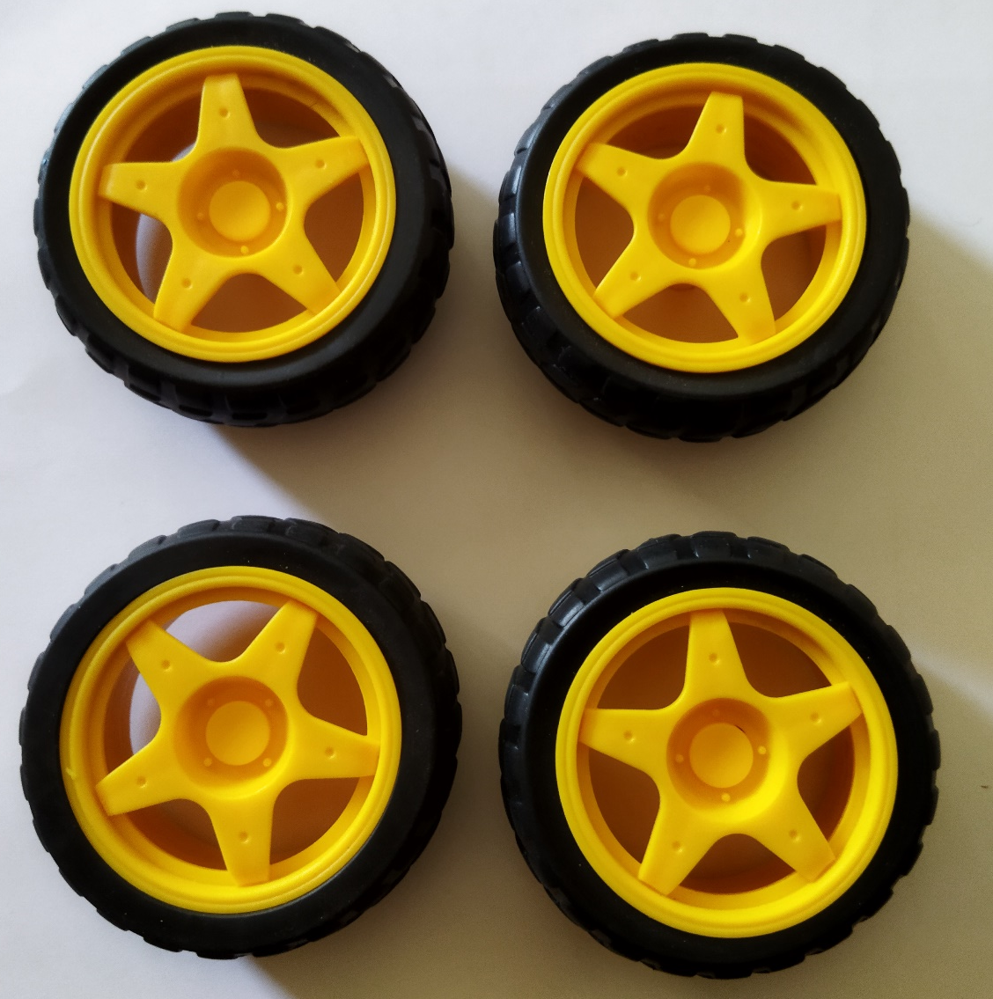
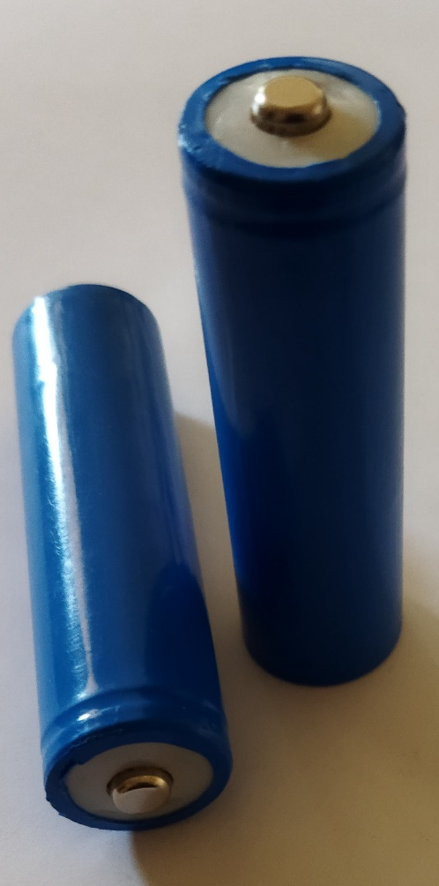
7) Four Gear Motor 8) Four Wheels
9) 7_Volt DC Battery

Slide 5
Code
About the project
The line follower's car begins to walk over the white roof. If any sensor gets close to the black line. The robot will turn against the direction of the black line. For example, a car sensor will detect the surface as either white or black. If both sensors are on black, the line follower will stop. And if both sensors are on the white surface, the robot will start moving. If the left sensor is on the black line, the car will move gently to the right. And the same for the other sensor. All the main work here is done by the sensor. The sensor detects the color and then the car reacts accordingly
To see video click here:
https://drive.google.com/file/d/1kZqi0PhnkXvVKcxl31oR9LpBm5o1BTkB/view?usp=share_link

Slide 6
#define M_A1 5 #define M_A2 6 #define M_B1 8 #define M_B2 9 #define LEFT_S 2 #define RIGHT_S 3 int Out_R_S = 0; int Out_L_S = 0; void setup() { pinMode(M_A1, OUTPUT); pinMode(M_A2, OUTPUT); pinMode(M_B1, OUTPUT); pinMode(M_B2, OUTPUT); pinMode(10, OUTPUT); pinMode(11, OUTPUT); pinMode(LEFT_S, INPUT); pinMode(RIGHT_S, INPUT);} void loop() { analogWrite(10,75); analogWrite(11,75); Out_R_S = digitalRead(RIGHT_S); Out_L_S = digitalRead(LEFT_S); | if (Out_R_S == 1 && Out_L_S == 0){ analogWrite(10,90); analogWrite(11,90); turnRight(); delay(500);} else if (Out_R_S == 0 && Out_L_S == 1){ analogWrite(10,90); analogWrite(11,90); turnLeft(); delay(500); } else if (Out_R_S == 1 && Out_L_S == 1){ Stop();} else if (Out_R_S == 0 && Out_L_S == 0){ Forward();}} void turnLeft() { digitalWrite(M_A1, HIGH); digitalWrite(M_A2, LOW); digitalWrite(M_B1, LOW); digitalWrite(M_B2, HIGH);} void turnRight() { digitalWrite(M_A1, LOW); digitalWrite(M_A2, HIGH); digitalWrite(M_B1, HIGH); digitalWrite(M_B2, LOW);} | void Backward() { digitalWrite(M_A1, HIGH); digitalWrite(M_A2, LOW); digitalWrite(M_B1, HIGH); digitalWrite(M_B2, LOW); } void Forward() { digitalWrite(M_A1, LOW); digitalWrite(M_A2, HIGH); digitalWrite(M_B1, LOW); digitalWrite(M_B2, HIGH); } void Stop() { digitalWrite(M_A1, LOW); digitalWrite(M_A2, LOW); digitalWrite(M_B1, LOW); digitalWrite(M_B2, LOW); }

Slide 7
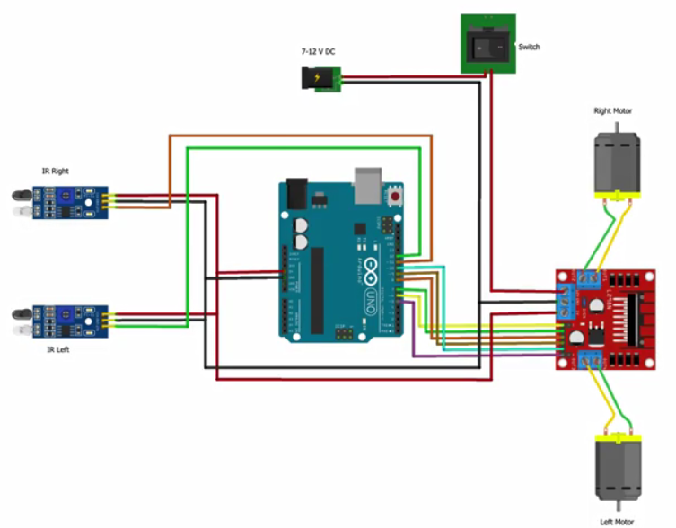
BLOCK DIAGRAM

